Slide 1
Colours
Amber
Grey
Indigo
Brown

Slide 2
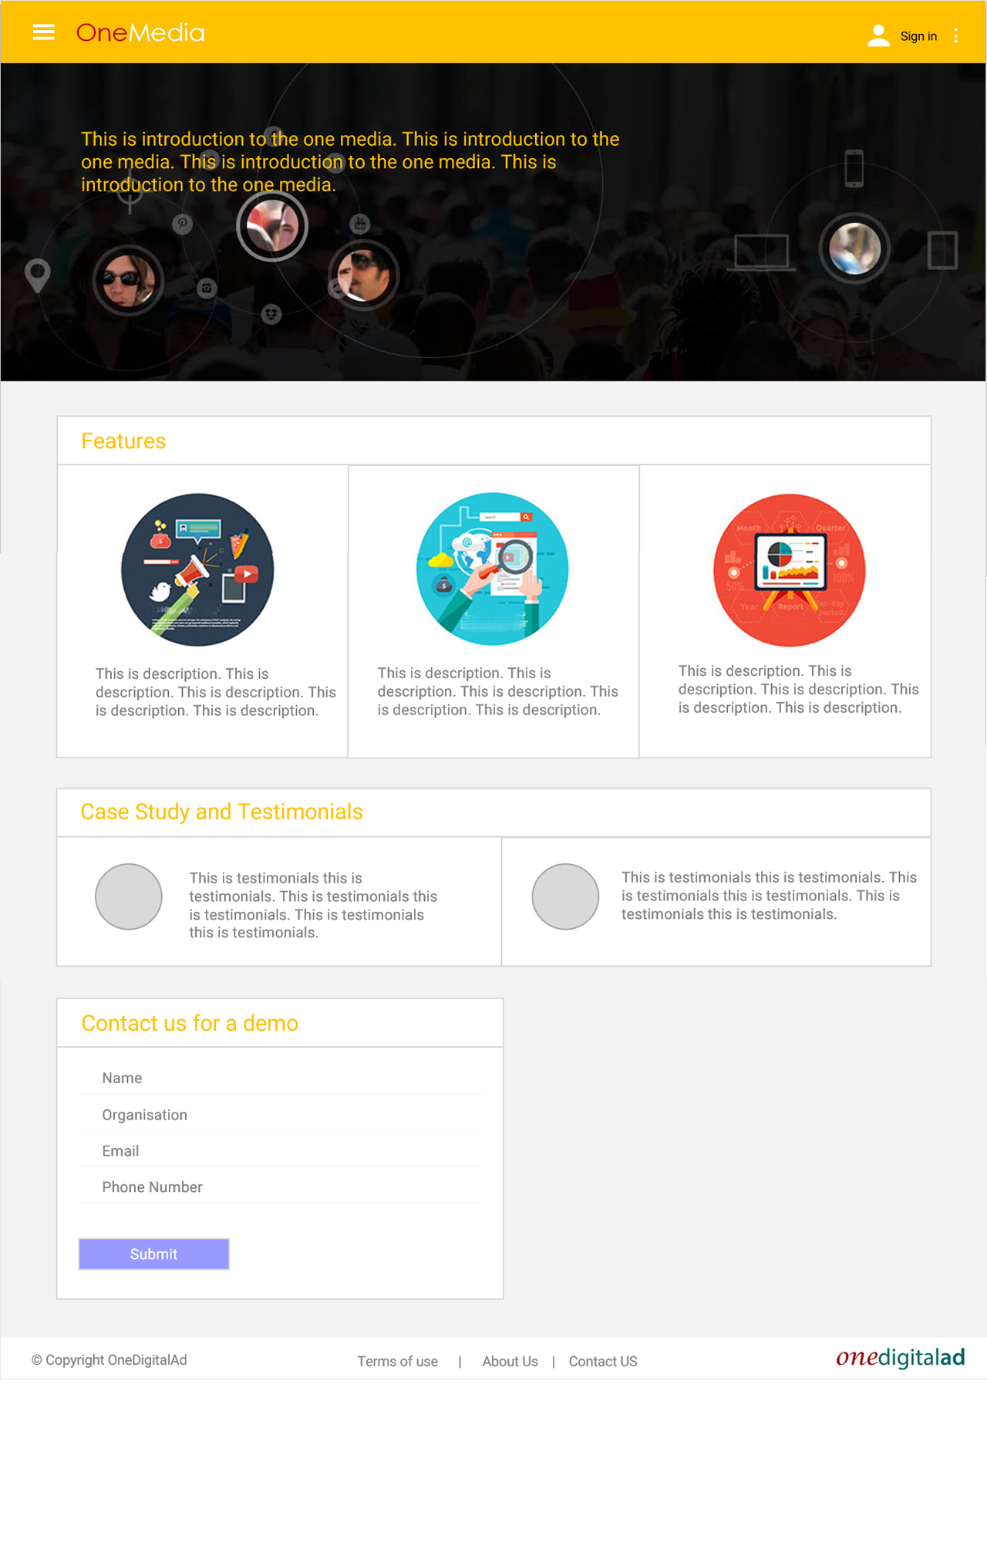
80 px
Roboto, verdana 15 pt, Amber 500
50 px
Min 50 px
Grey 100
60 px
50 px
Grey 400
Roboto, verdana 16 pt, Amber 700
Roboto, verdana 12 pt, Gray 600
Roboto, verdana 14 pt, Indigo 300

Slide 3
Roboto, verdana 12 pt, Gray 900
45 px
30 px
15 px
30 px
35 px
35 px
35 px
60 px
45 px

Slide 4
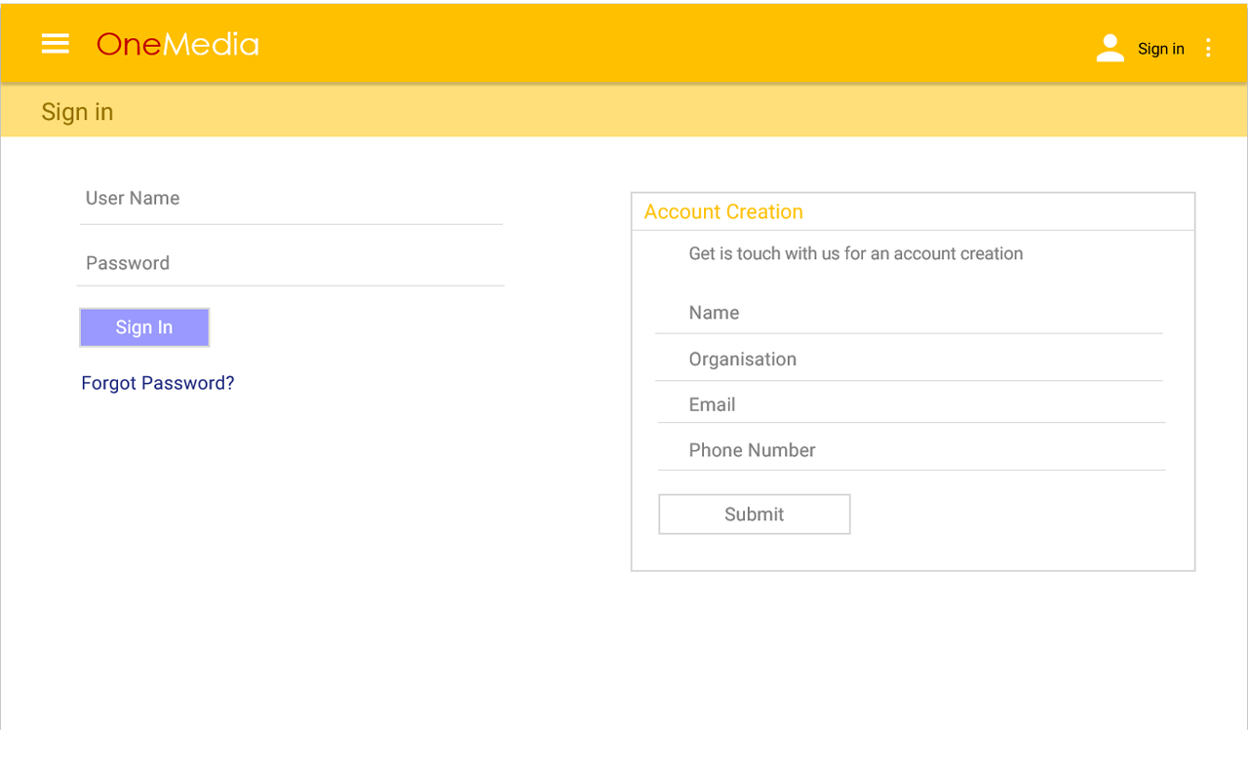
45 px
Min 50 px

Slide 5
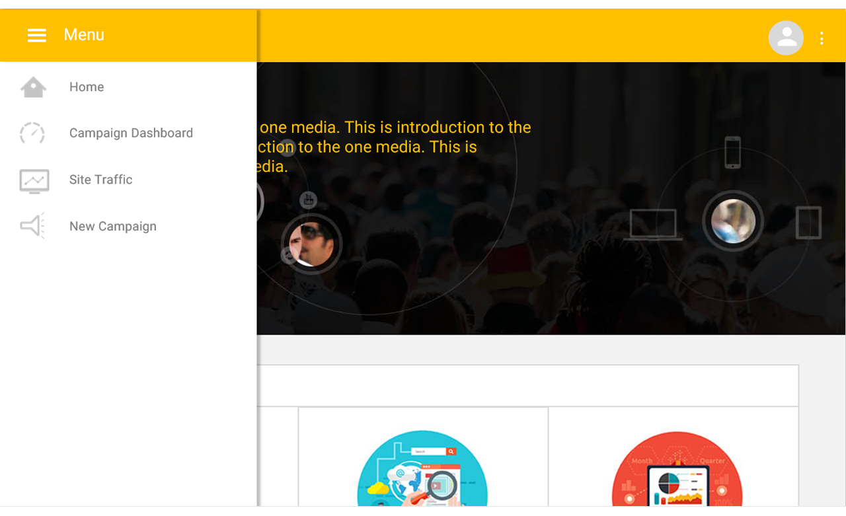
325 px
Roboto, verdana 14 pt, Gray 600
75 px
30 px
45 px

Slide 6
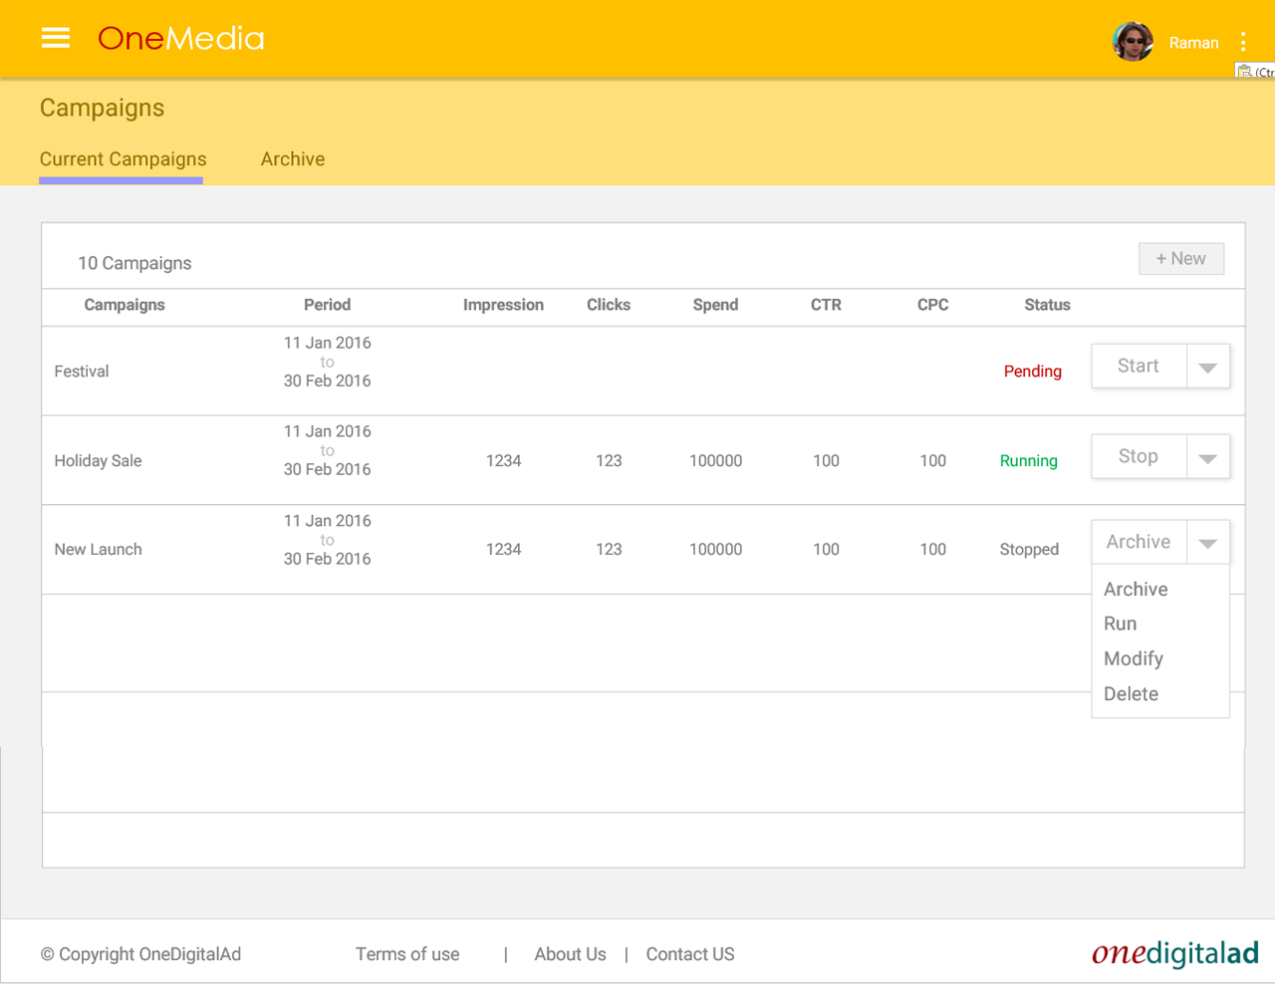
Roboto, verdana 16 pt, Brown 600
75 px
15 px
Min 50 px

Slide 7
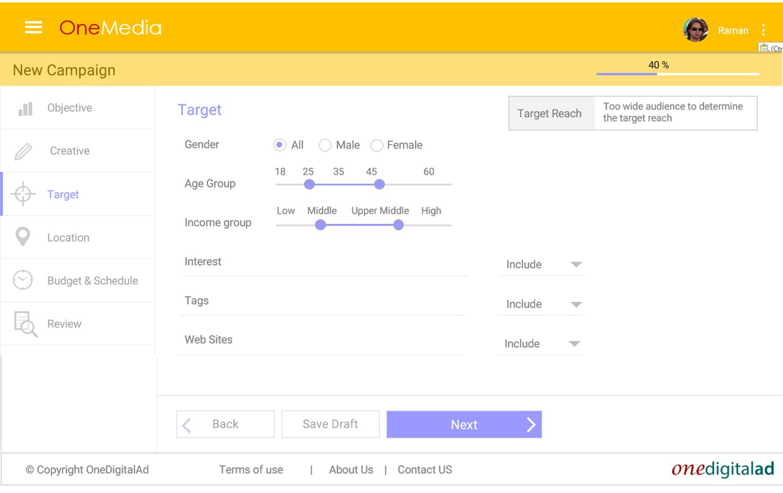
Roboto, verdana 16 pt, Indigo 300
75 px
45 px
45 px
45 px
100 px
15 px

Slide 8
1280

Slide 9
1900

Slide 10
600

